Slide 1
OpenSCAD
https://lamm.space/
3D Design Day 2017
@idnorton

Slide 2
I’m not an
OpenSCAD expert… :)

Slide 3
Why OpenSCAD?
Absolute positioning and sizing
Programmatic
Works on most OS

Slide 4
Why OpenSCAD?
Absolute positioning and sizing
Programmatic
Works on most OS
I really hate graphical tooling :/

Slide 5
Which version?

Slide 6
Which version?
>= 2015.03
Adds support for text

Slide 7
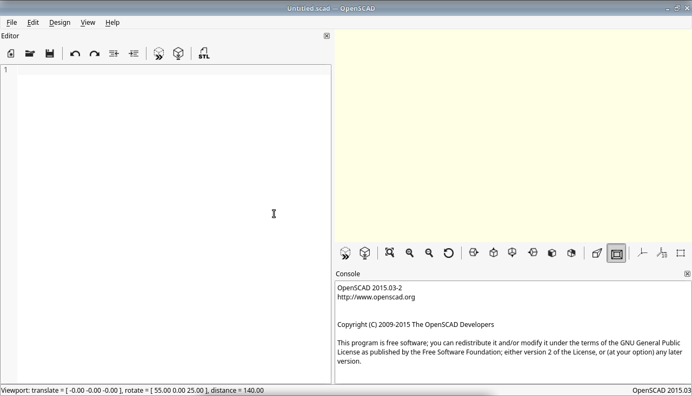

Slide 8
Preview here!
Code here!
Output / Errors here!

Slide 9
Simple Example

Slide 10
Simple Example
Cube
cube(size = 10, center = false);

Slide 11
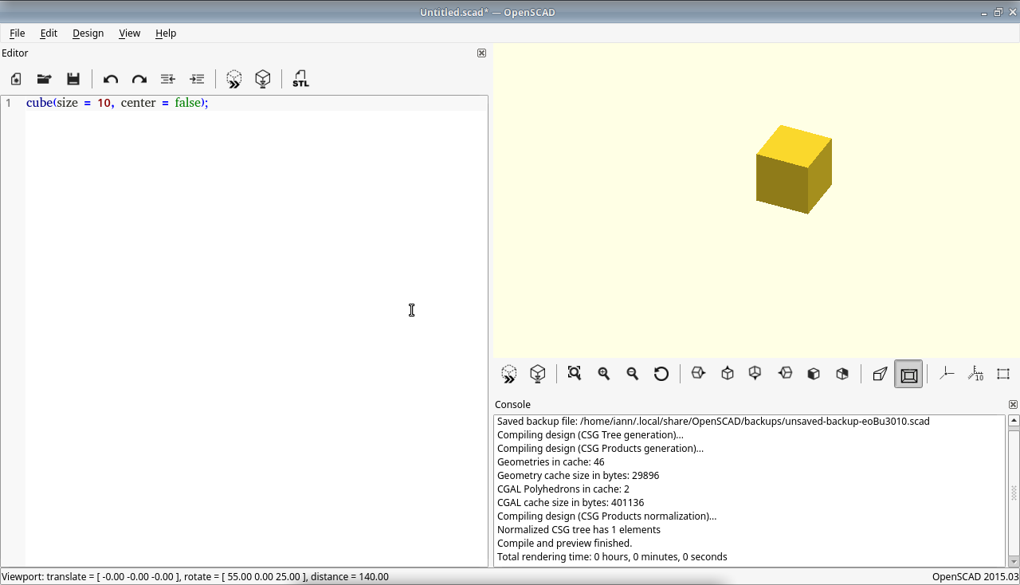

Slide 12
Preview pane

Slide 13
Navigating preview
Left mouse button
  Move in 3d

Slide 14
Navigating preview
Left mouse button
  Move in 3d
Right mouse button
  Move in 2d

Slide 15
Navigating preview
Left mouse button
  Move in 3d
Right mouse button
  Move in 2d
Scroll wheel to zoom in and out

Slide 16
2D Shapes

Slide 17
Square
square(size = [x, y], center = true/false);
square(size = [x, y], center = true/false);
square(size = [10, 10], center = false);

Slide 18
Circle
circle(r=radius | d=diameter);
circle(d = 10);

Slide 19
Making 2D thing

Slide 20
Positioning
Circle at x 10, y 20, with diameter 30
translate([x, y]) {
// Add your thing here
}
translate([10, 20]) {
circle(d = 30);
}

Slide 21
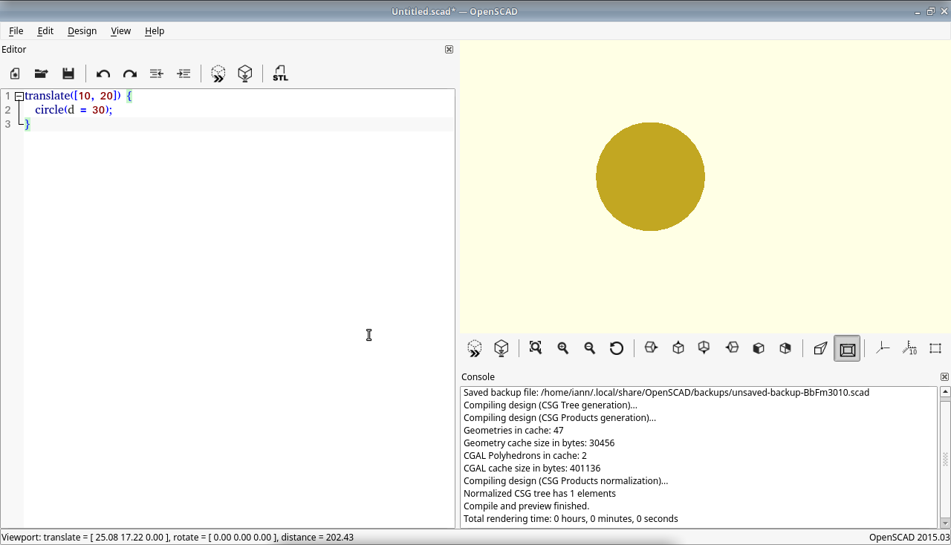

Slide 22
Positioning
More than one circle
translate([10, 20]) {
circle(d = 30);
}
translate([50, 20]) {
circle(d = 30);
}

Slide 23
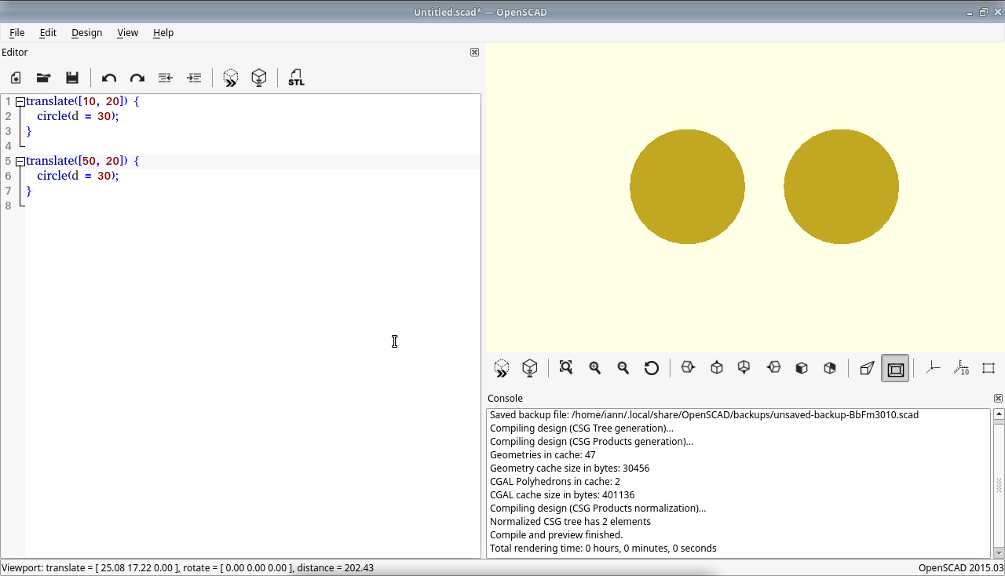

Slide 24
Combining objects

Slide 25
difference
difference() {
// Outer circle 50mm diameter
circle(d = 50);
// Hole through the middle 20mm diameter
circle(d = 20);
}

Slide 26
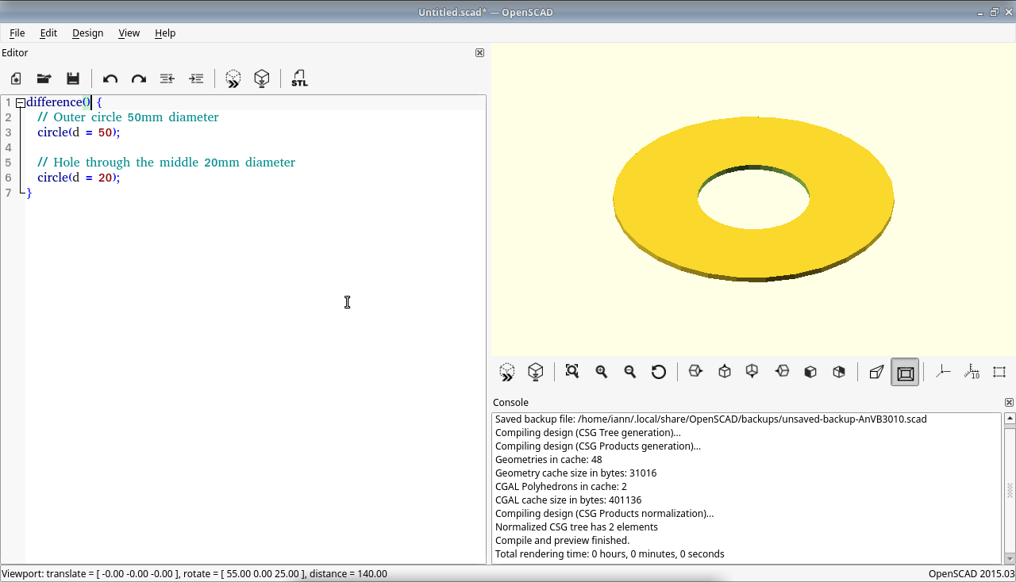

Slide 27
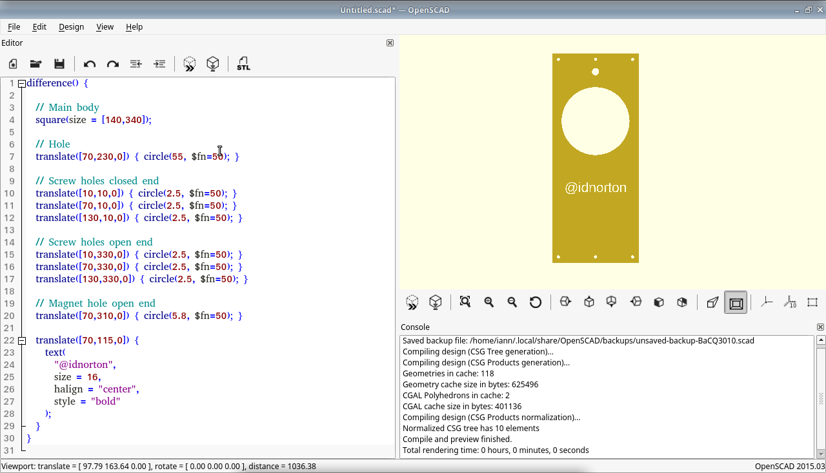
More complex example

Slide 28
Other combinations
union
difference
intersection
render

Slide 29
3D Shapes

Slide 30
Cube
cube(size = [x,y,z], center = true/false);
cube(size = 10, center = false);

Slide 31
Cylinder
Cylinder(
h = height,
r1 = BottomRadius,
r2 = TopRadius,
center = true/false
);

Slide 32
Further reading
http://www.openscad.org/
https://en.wikibooks.org/wiki/OpenSCAD_User_Manual
https://github.com/lammspace/3d-printer-shelves
https://github.com/lammspace/Laser-Supply-Storage
https://github.com/idnorton/hardware-designs

Slide 33
Questions
&
Answers

Slide 34
Thanks for listening!

